Slide 1
Introduction to Databases CT042-3-1-IDB (version1)
Week 12: Database Development Life Cycle

Slide 2
Topic & Structure of The Lesson
Systems Development Life Cycle (SDLC)
Database Life Cycle (DBLC)

Slide 3
Learning Outcomes
At the end of this topic, You should be able to
Describe framework known as the Systems Development Life Cycle (SDLC) and Database Life Cycle (DBLC)

Slide 4
Key Terms You Must Be Able To Use
If you have mastered this topic, you should be able to use the following terms correctly in your assignments and exams:
SDLC
DBLC
Planning
Analysis
Design
Implementation
Maintenance

Slide 5
The Information System
Provides for data collection, storage, and retrieval
Composed of people, hardware, software, database(s), application programs, and procedures
Systems analysis
Process that establishes need for and extent of information system
Systems development
Process of creating information system

Slide 6
The Information System (continued)
Applications
Transform data into information that forms basis for decision making
Usually produce the following:
Formal report
Tabulations
Graphic displays
Composed of following two parts:
Data
Code by which data are transformed into information

Slide 7
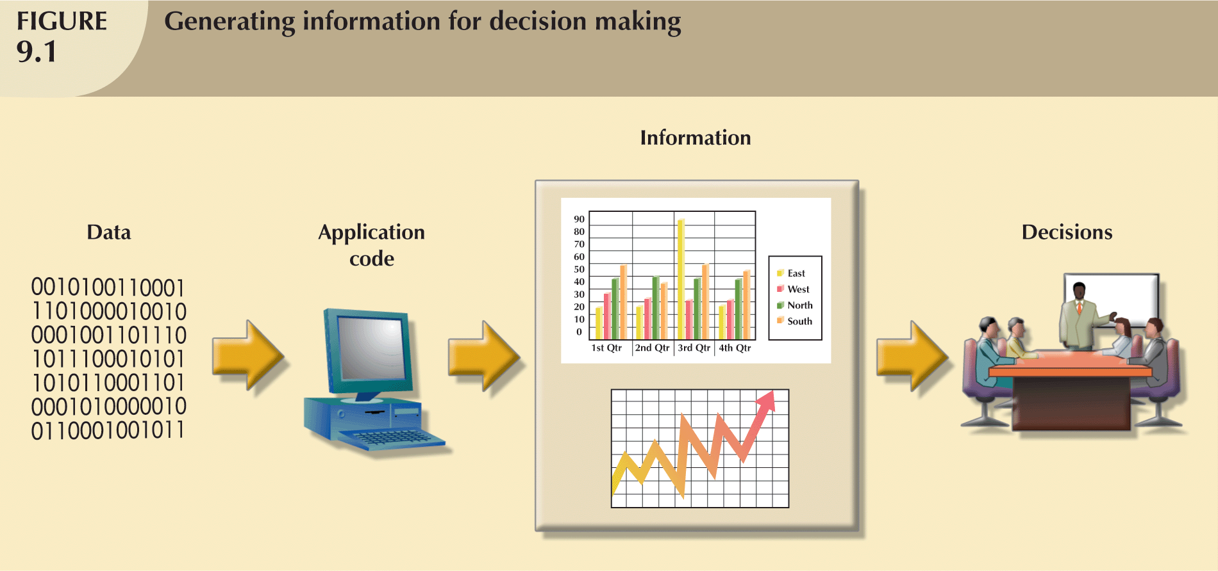
The Information System (continued)

Slide 8
The Information System (continued)
Information system performance depends on triad of factors:
Database design and implementation
Application design and implementation
Administrative procedures
Database development
Process of database design and implementation
Primary objective is to create complete, normalized, nonredundant (to the extent possible), and fully integrated conceptual, logical, and physical database models

Slide 9
The Systems Development Life Cycle (SDLC)
Traces history (life cycle) of information system
Provides “big picture” within which database design and application development can be mapped out and evaluated

Slide 10
The Systems Development Life Cycle (SDLC) (continued)
Divided into following five phases:
Planning
Analysis
Detailed systems design
Implementation
Maintenance
Iterative rather than sequential process

Slide 11
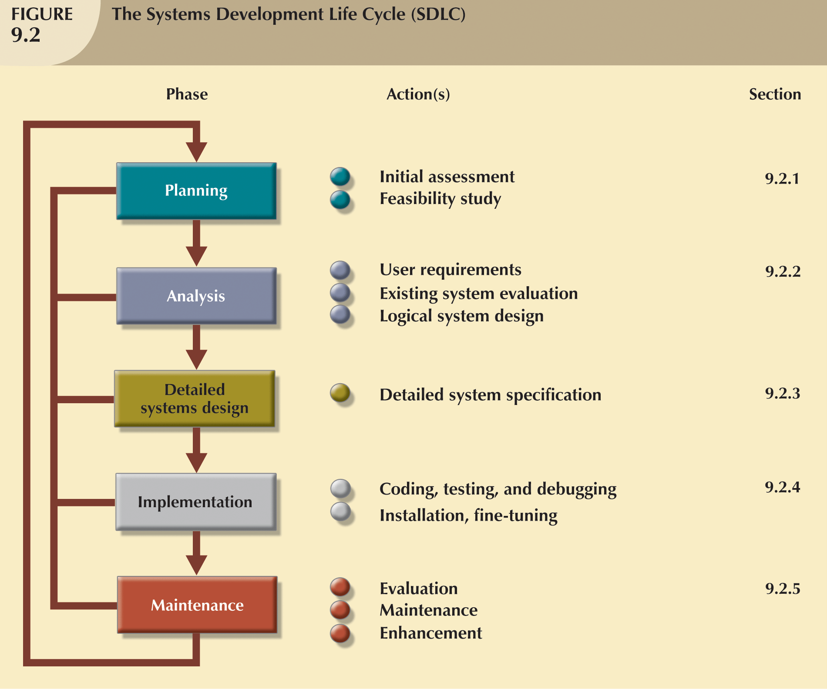
The Systems Development Life Cycle (SDLC) (continued)

Slide 12
Planning
Yields general overview of company and its objectives
Initial assessment made of information-flow-and-extent requirements
Must begin to study and evaluate alternate solutions
Technical aspects of hardware and software requirements
System cost

Slide 13
Analysis
Problems defined during planning phase are examined in greater detail during analysis
Thorough audit of user requirements
Existing hardware and software systems are studied
Goal is better understanding of system’s functional areas, actual and potential problems, and opportunities

Slide 14
Analysis (continued)
Includes creation of logical system design
Must specify appropriate conceptual data model, inputs, processes, and expected output requirements
Might use tools such as data flow diagrams (DFDs), hierarchical input process output (HIPO) diagrams, and entity relationship (ER) diagrams
Yields functional descriptions of system’s components (modules) for each process within database environment

Slide 15
Detailed Systems Design
Designer completes design of system’s processes
Includes all necessary technical specifications
Steps are laid out for conversion from old to new system
Training principles and methodologies are also planned

Slide 16
Implementation
Hardware, DBMS software, and application programs are installed, and database design is implemented
Cycle of coding, testing, and debugging continues until database is ready to be delivered
Database is created and system is customized by creation of tables and views, and user authorizations

Slide 17
Maintenance
Maintenance activities group into three types:
Corrective maintenance in response to systems errors
Adaptive maintenance due to changes in business environment
Perfective maintenance to enhance system
Computer-assisted systems engineering
Make it possible to produce better systems within reasonable amount of time and at reasonable cost

Slide 18
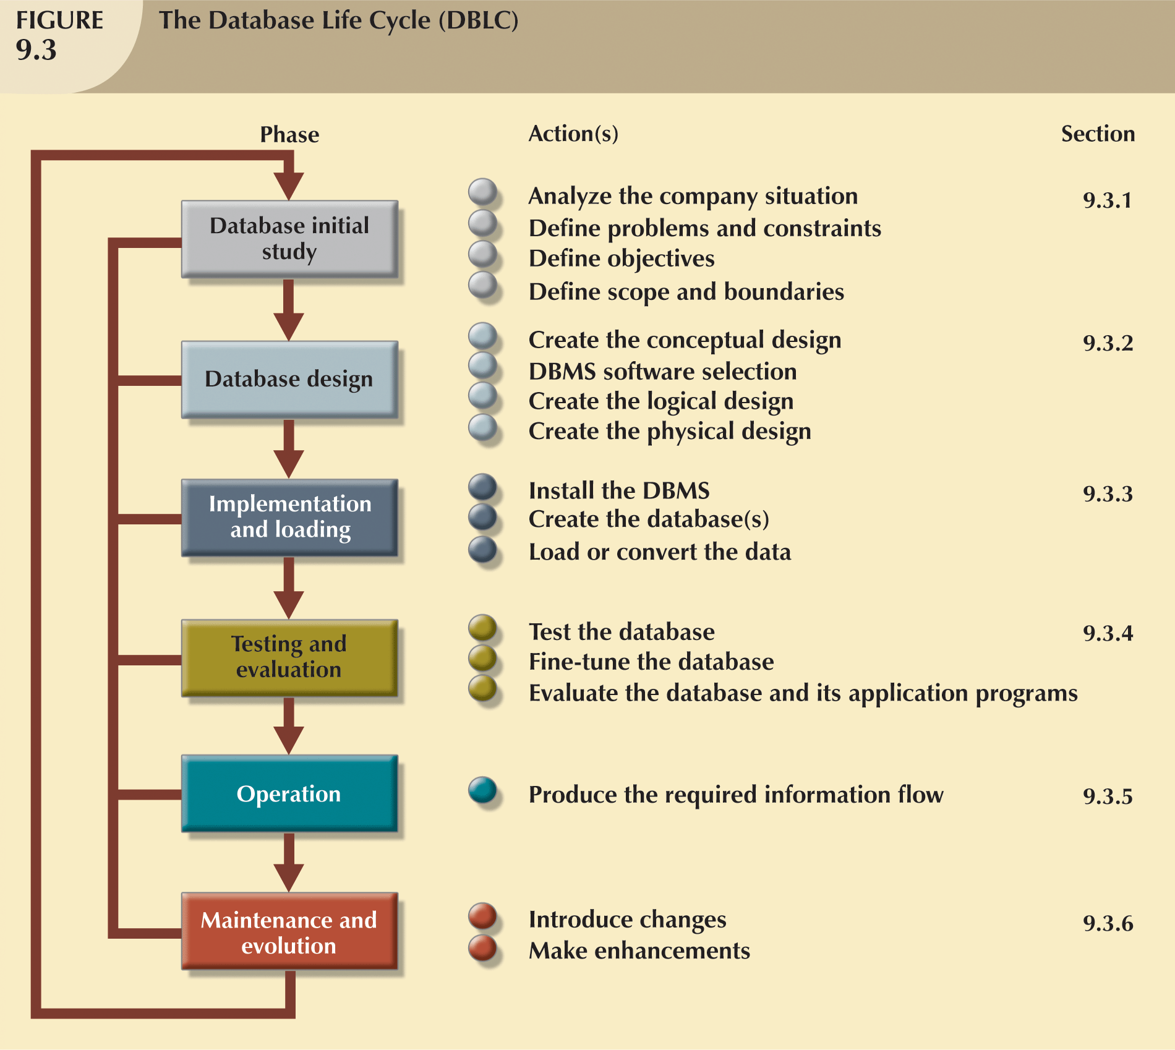
The Database Life Cycle (DBLC)

Slide 19
The Database Initial Study
Overall purpose:
Analyze company situation
Define problems and constraints
Define objectives
Define scope and boundaries
Interactive and iterative processes required to complete first phase of DBLC successfully

Slide 20
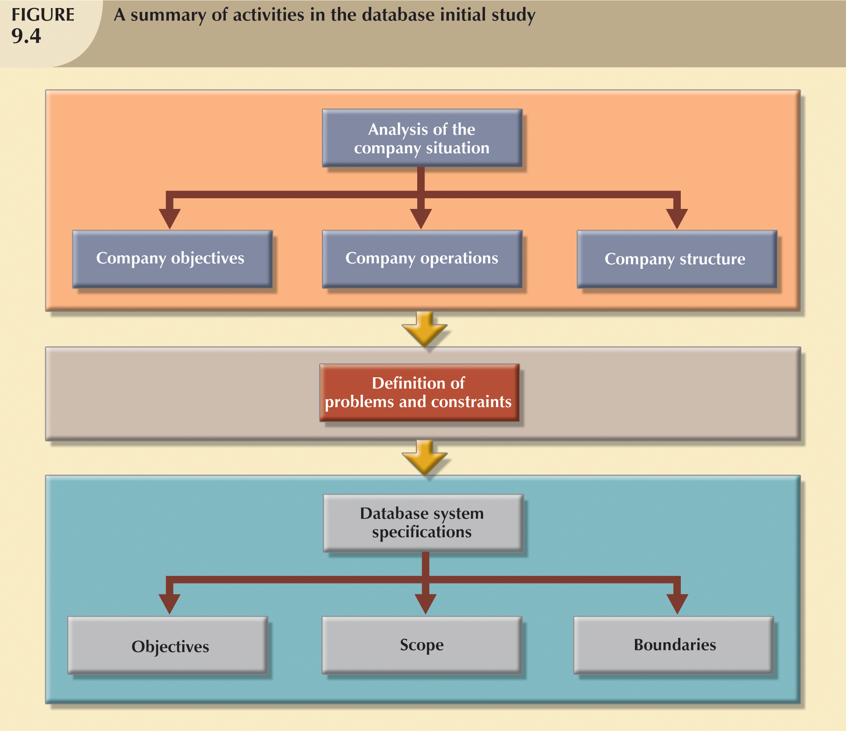
The Database Initial Study (continued)

Slide 21
Analyze the Company Situation
Analysis–To break up any whole into its parts so as to find out their nature, function, and so on
Company situation
General conditions in which company operates, its organizational structure, and its mission
Analyze company situation
Discover what company’s operational components are, how they function, and how they interact

Slide 22
Define Problems and Constraints
Managerial view of company’s operation is often different from that of end users
Designer must continue to carefully probe to generate additional information that will help define problems within larger framework of company operations
Finding precise answers is important
Defining problems does not always lead to perfect solution

Slide 23
Define Objectives
Designer must ensure that database system objectives correspond to those envisioned by end user(s)
Designer must begin to address following questions:
What is proposed system’s initial objective?
Will system interface with other existing or future systems in the company?
Will system share data with other systems or users?

Slide 24
Define Scope and Boundaries
Scope
Defines extent of design according to operational requirements
Helps define required data structures, type and number of entities, and physical size of database
Boundaries
Limits external to system
Often imposed by existing hardware and software

Slide 25
Quick Review Question
Briefly describe the phases of SDLC
Briefly describe the phases of DBLC

Slide 26
Summary of Main Teaching Points
Information system is designed to facilitate transformation of data into information and to manage both data and information
SDLC traces history (life cycle) of an application within the information system
DBLC describes history of database within the information system
Database design and implementation process moves through series of well-defined stages

Slide 27
Question and Answer Session
Q & A

Slide 28
What we will cover next
Database Implementation

